Slide 1
Social networks and Entertainment in Spain
My Space, hi 5, spotify and Apple music

Slide 2

My Space
MySpace was founded in 2003 by Chris DeWolfe and Tom Anderson. It started as a social networking site like Friendster.
That same year, the industry leader, Friendster, had a major setback technology. Tons of Friendster users tired and ended up moving to MySpace through word of mouth. It was the most important social network between 2007 and 2008.

Slide 3

MySpace. How does it work?
When you become a member of My Space you create your own profile, then invite your friends to become members and looking at MySpace friends of yours who are already members.

Slide 4
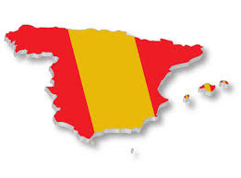
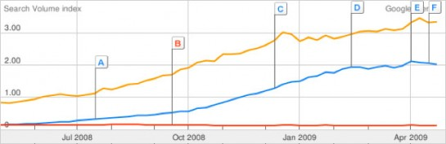
Influence of My Space in Spain
Facebook MySpace Tuenti

Slide 5

HI 5
Hi5 is a social network founded by Ramu Yalamanchi (current CEO of the company hi5 Networks) and was thrown in 2003. At the end of 2007 was over 70 million registered users, most of them in Latin America users; plus it was one of the 40 most visited websites in the world.

Slide 6
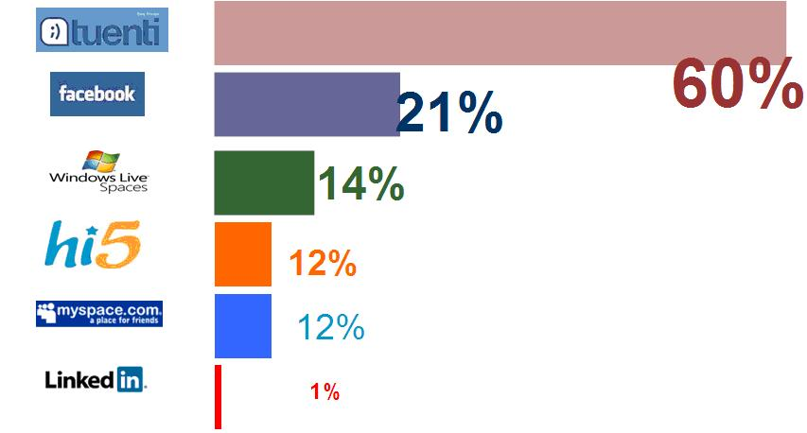
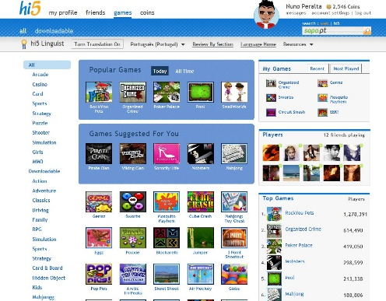
Influence of Hi 5 in Spain

Slide 7

Apple Music vs Spotify
What are these entertainment?

Slide 8
Apple Music vs Spotify
 | Apple Music | Spotify
Monthly fee | US $ 9.99 per month per individual plan | US $ 14.99 per family plan US $ 9.99 per month
¿Free option? | Yes, with limited functions | Yes, with ads
Trial period | Three months | 30 days
Library size | 30 million | 30 million
Offline mode? | Yes, with paid subscription | Yes, with paid subscription
App available for | iOS, Mac, Windows, Android and Apple TV in the fall of 2015 | Windows, Mac, PlayStation 3 and higher, Android, iOS, Windows Phone

Slide 9

Influence of Apple Music and Spotify in Spain

