Slide 1
Longino Soto Pacheco
Biography

Slide 2
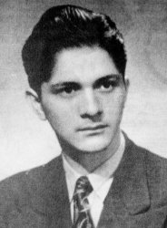
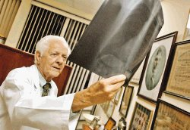
Who was Longino Soto?

Slide 3
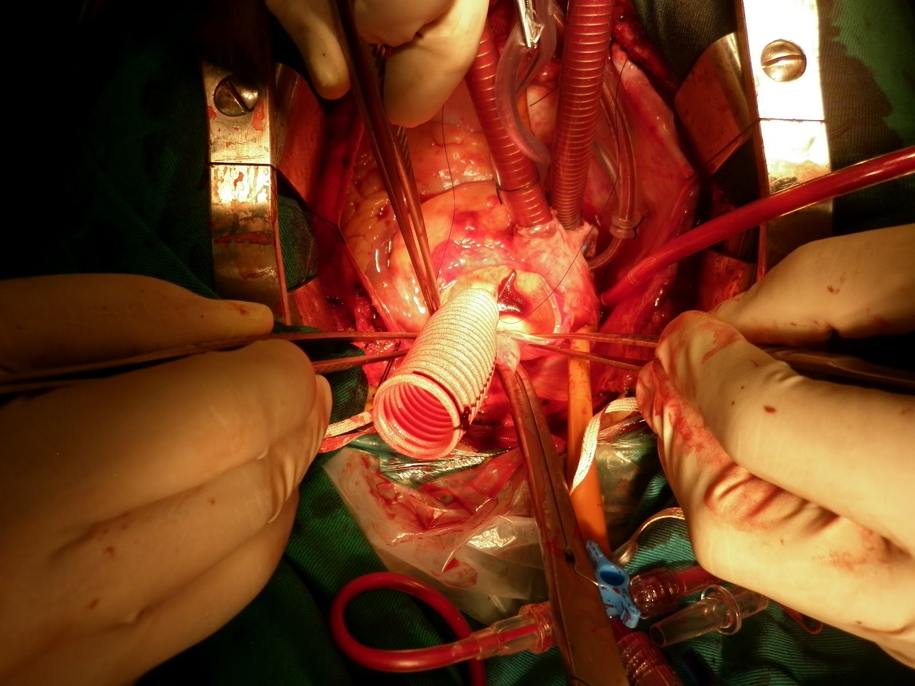

Achievements in the area of Medicine

Slide 4
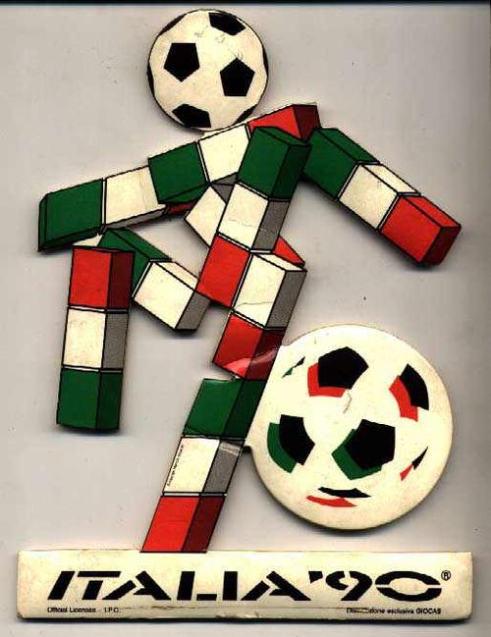

Achievements in UNAFUT

Slide 5
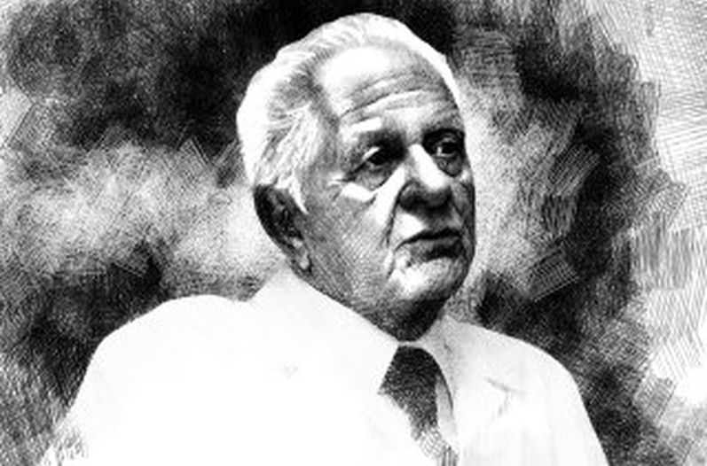
Last years of life
He died in October 13, 2010

Slide 6
https://www.youtube.com/watch?v=CvggYIHCuGE

