Slide 1

#Nosextraffickingofchildren

Slide 2

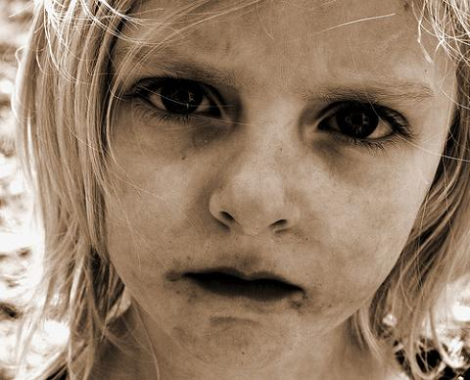
What kind of slavery it is? Why is it modern day slavery?
#Nosextraffickingofchildren

Slide 3
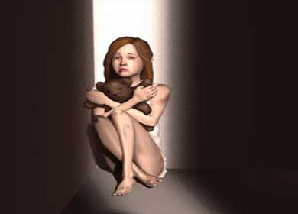
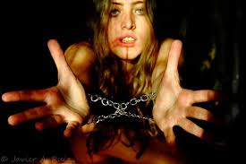
What are some characteristics about it?
#Nosextraffickingofchildren

Slide 4

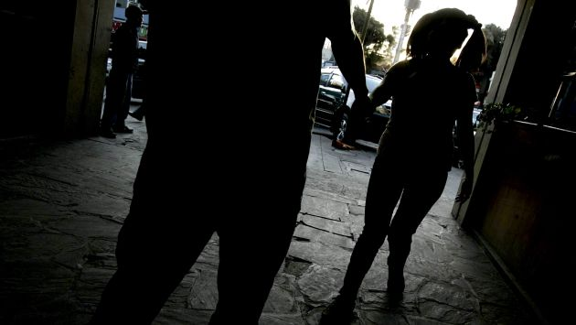
Describe this type of modern day slavery
#Nosextraffickingofchildren

Slide 5

What do you think about that type of slavery?
#Nosextraffickingofchildren

Slide 6
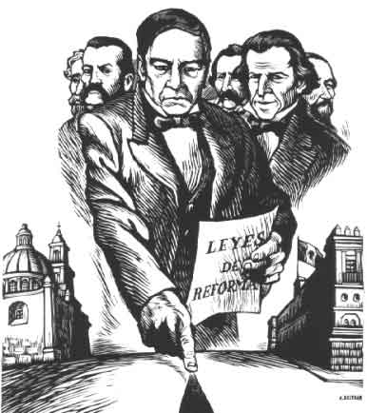

What would you do to help people who are enslaved?
#Nosextraffickingofchildren

Slide 7
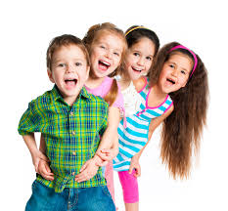
How is these people’s life different from yours?
#Nosextraffickingofchildren

