Slide 1
Similarities and differences between Tennis and dance
Members:
Priscilla Romero Aguilar
Jahzeel Cordero Cordero

Slide 2
Venn Diagram
Tennis
Tennis is a sport followed by millons of people.
The Tennis is a sport of coordination
Playing tennis singles is easier.
It’s very physical game.
Playing tennis outdoors is more difficult.
Dancing
Dancing is a important sport.
Dancing have many kinds of rhythms.
You need move all your body.
There are many competition of dance.
Dancingis beautiful.

Slide 3

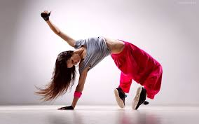
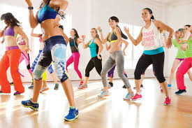
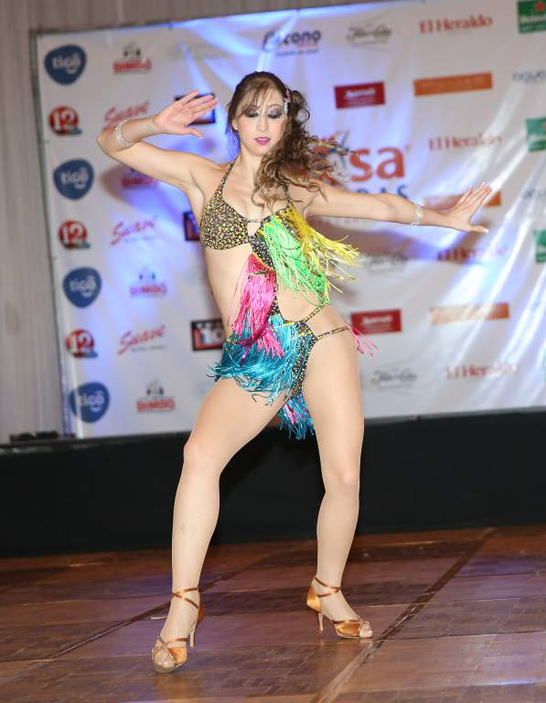
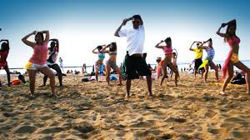
Dance

Slide 4
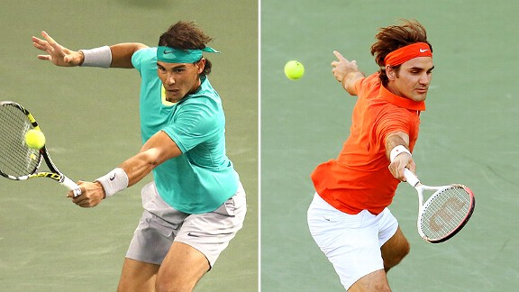
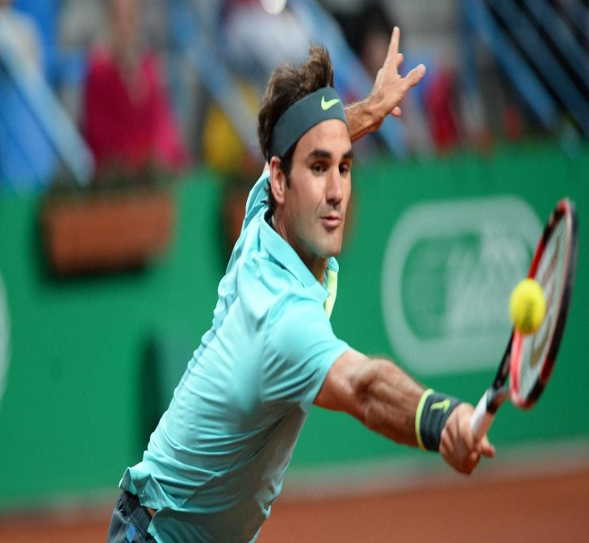
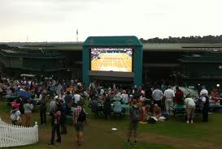
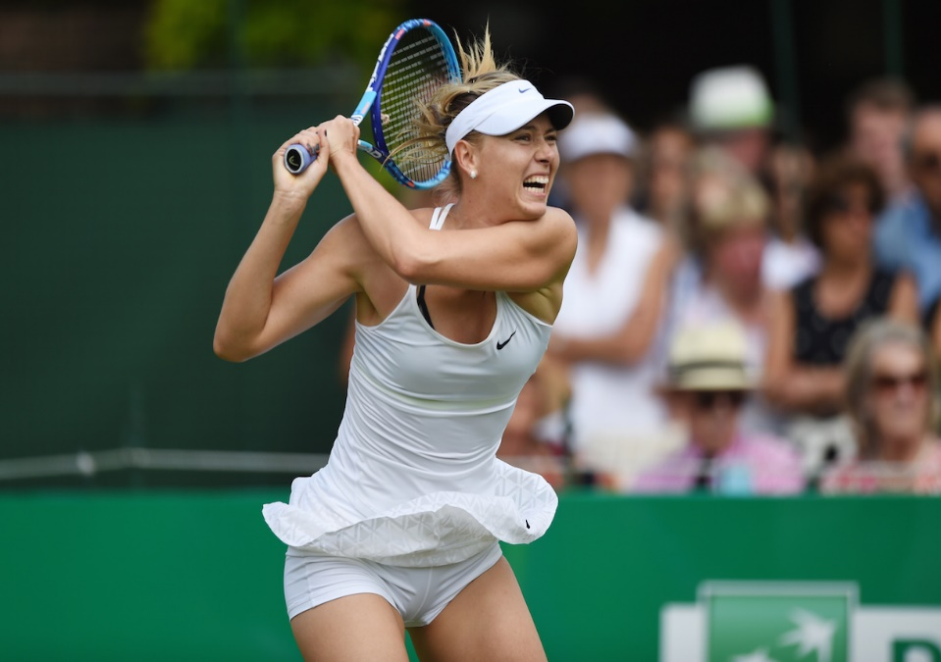
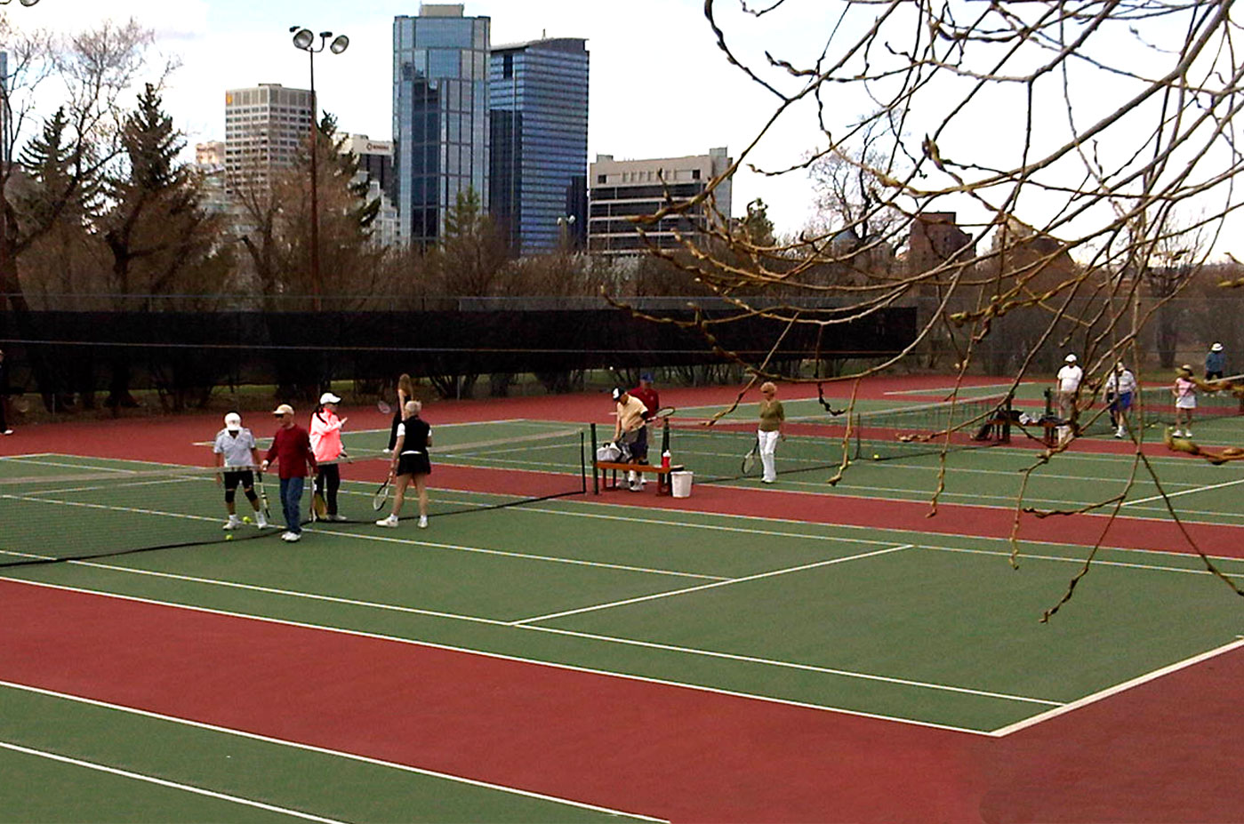
Tennis

Slide 5
Similarities
In both sports you can practice outdoors and indoors.
In tennis and dancing you need move all the body.
In both sports you need a lot of coordination.

