Slide 1
Influence of Media
On Children’s behavior
Jahzeel Cordero
Diana Leon
Carlos Pastrana
Pricilla Romero
Michelle Zuñiga

Slide 2
Introduction
Internet
Negative influence
Positive influence
Televison
Negative influence
Positive influence
Music
Negative Influence
Positive influence
Tips for good use
Tips for good use
Tips for good use

Slide 3
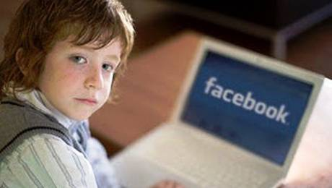
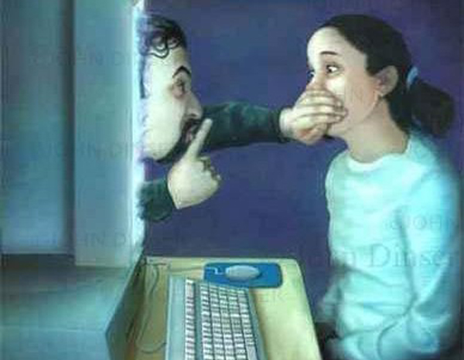
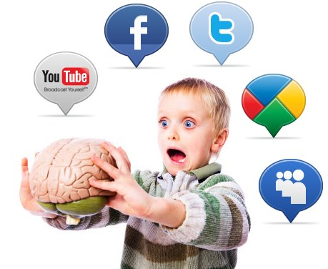
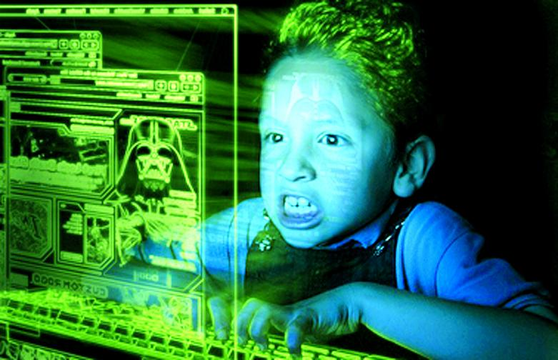
Internet

Slide 4
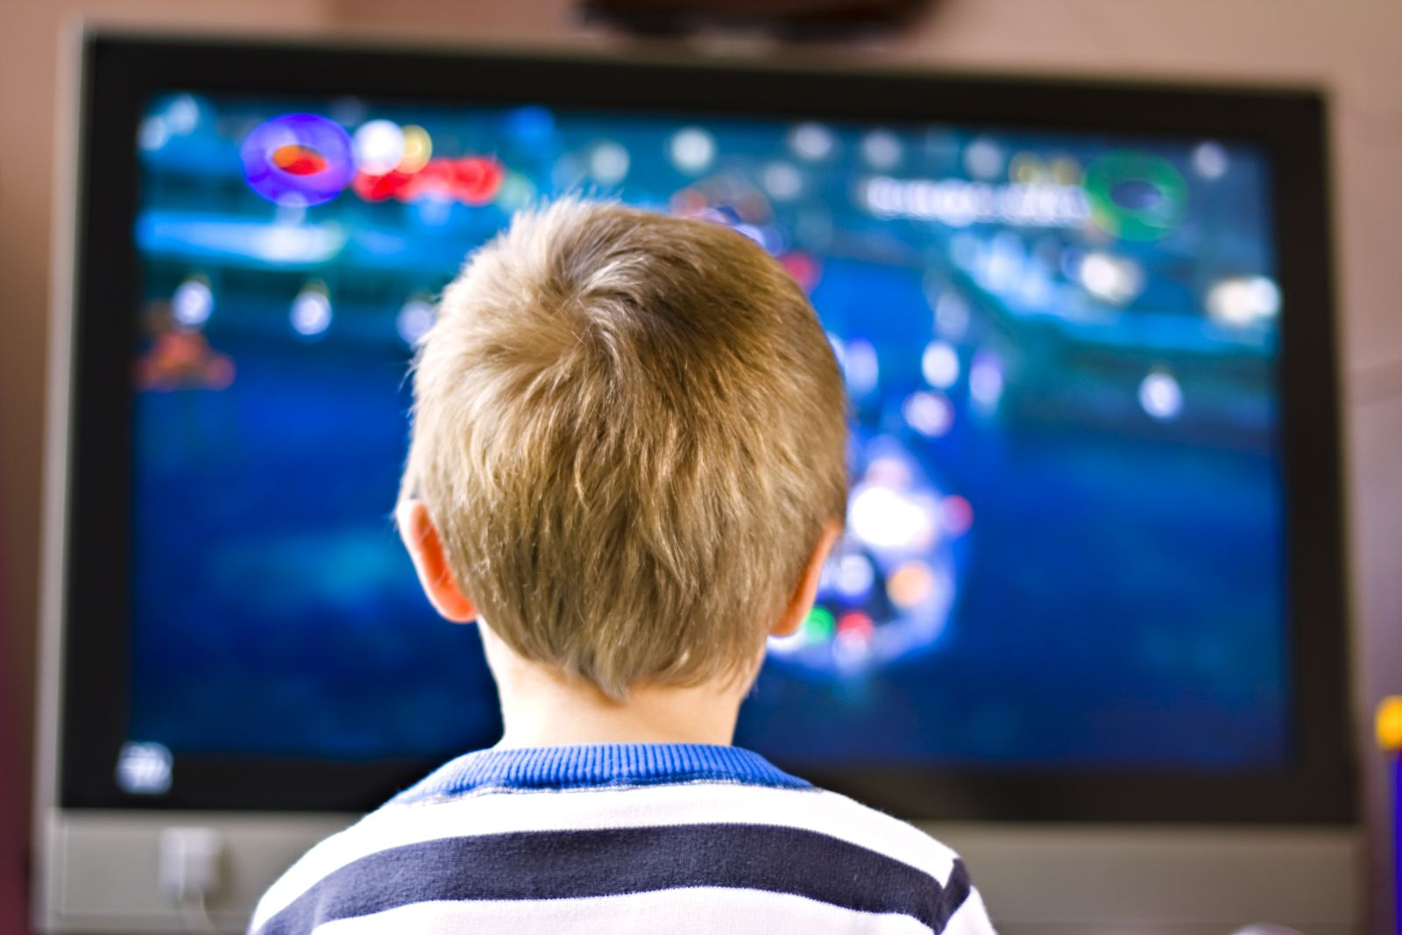
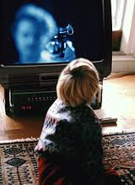
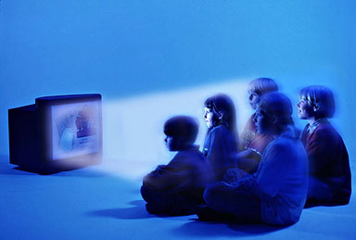
Television

Slide 5
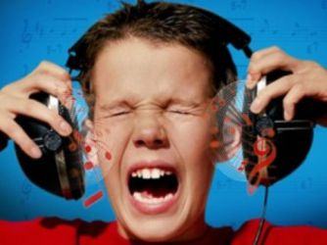
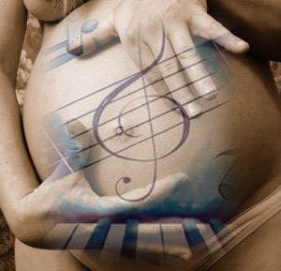
Music

Slide 6
Conclusion

Slide 7

Video

Slide 8
Thanks for your attention
.

